Slide 1
15.2 Boolean Algebra and Logic Circuits
Produce truth tables for logic circuits including half adders and full adders
Show understanding of a flip-flop (SR, JK)
Show understanding of Boolean algebra
Show understanding of Karnaugh maps (K-map)
May include logic gates with more than two inputs.
Draw a logic circuit and derive a truth table for a flip-flop
Understand of the role of flip-flops as data storage elements
Understand De Morgan’s laws.
Perform Boolean algebra using De Morgan’s laws.
Simplify a logic circuit/expression using Boolean algebra
Understand of the benefits of using Karnaugh maps Solve logic problems using Karnaugh maps
Notes:
Produce truth tables for logic circuits including half adders and full adders
Show understanding of a flip-flop (SR, JK)
Show understanding of Boolean algebra
Show understanding of Karnaugh maps (K-map)
May include logic gates with more than two inputs.
Draw a logic circuit and derive a truth table for a flip-flop
Understand of the role of flip-flops as data storage elements
Understand De Morgan’s laws.
Perform Boolean algebra using De Morgan’s laws.
Simplify a logic circuit/expression using Boolean algebra
Understand of the benefits of using Karnaugh maps Solve logic problems using Karnaugh maps

Slide 2
Today
3. Show understanding of Boolean algebra
8. Show understanding of de Morgan's laws
9. Perform Boolean algebra using de Morgan's laws
10. Simplify a logic circuit/expression using Boolean algebra
Understand : How to write Boolean algebra
Able : Identify the laws regarding Boolean algebra
Answer : What are the symbols used
Notes:
Produce truth tables for logic circuits including half adders and full adders
Show understanding of a flip-flop (SR, JK)
Show understanding of Boolean algebra
Show understanding of Karnaugh maps (K-map)
May include logic gates with more than two inputs.
Draw a logic circuit and derive a truth table for a flip-flop
Understand of the role of flip-flops as data storage elements
Understand De Morgan’s laws.
Perform Boolean algebra using De Morgan’s laws.
Simplify a logic circuit/expression using Boolean algebra
Understand of the benefits of using Karnaugh maps Solve logic problems using Karnaugh maps

Slide 3
Before we begin
Quick review of logic gates

Slide 4
AND
Two inputs
One output
Input 1 AND Input 2 must be on for Output to be ON
Written as A • B = Output
Input A | Input B | Output
0 | 0 | 0
0 | 1 | 0
1 | 0 | 0
1 | 1 | 1

Slide 5
OR
Two inputs
One output
Input 1 OR Input 2 must be on for Output to be ON
Written as A + B = Output
(yes I know using + is stupid for OR)
Input A | Input B | Output
0 | 0 | 0
0 | 1 | 1
1 | 0 | 1
1 | 1 | 1

Slide 6
NOT
ONE inputs
One output
If Input in OFF then output is ON
If Input is ON then output is OFF
Written as Ā
Input A | Output
0 | 1
1 | 0

Slide 7
Quick Quiz
Name 2 logic gates
Name 2 more
And 2 more please
Why do we use logic gates?
Which gate has two inputs?
Which gate has one input
What does + mean?
Which gate needs to have input 1 and Input 2 on for output to be on?
Which gate has one output?
Which gate is simply the opposite of the input?
What are the names of the table?

Slide 8
NAND
Stands for NOT AND
Two Inputs
One Output
Output is ON unless both inputs are ON
Written as A . B = Output
Input A | Input B | Output
0 | 0 | 1
0 | 1 | 1
1 | 0 | 1
1 | 1 | 0

Slide 9
NOR
Stands for NOT OR
Two Inputs
One Output
If any Input is ON then output is OFF
Written as A + B = Output
Input A | Input B | Output
0 | 0 | 1
0 | 1 | 0
1 | 0 | 0
1 | 1 | 0

Slide 10
XOR or EOR
Stands for Exclusive OR
Two Inputs
One Output
If the Inputs are the same then then output is OFF
Written as A B
Input A | Input B | Output
0 | 0 | 0
0 | 1 | 1
1 | 0 | 1
1 | 1 | 0

Slide 11
Symbols and meaning
In decimal
1 + 1 = 2
Means 1 add 1 equals 2
In binary
1 + 1 = 10
Means 1 add 1 equals 10
In Boolean
1 + 1 = 1
Means True (1) OR True (1) equals TRUE (1)
Because 1 is True, 0 is False and + is OR

Slide 12
Symbols
They are not standard.
You can write:
A.B
AB
A^B
All mean A AND B
We will use what Cambridge use, but when you research be careful.

Slide 13
Laws
Once you know the notation you can now make some laws / identity
You don’t need to know about the names. Just know that all the laws have an AND form and an OR form
*All laws apart from
Double Complement
Its worth noting that if you
change AND to OR the output
is opposite

Slide 14
3 Minute task
Write the laws in AND form and OR form. But write as their true Boolean expression
1 + A = 1
But it SHOULD and MUST be:
TRUE OR A = TRUE

Slide 15
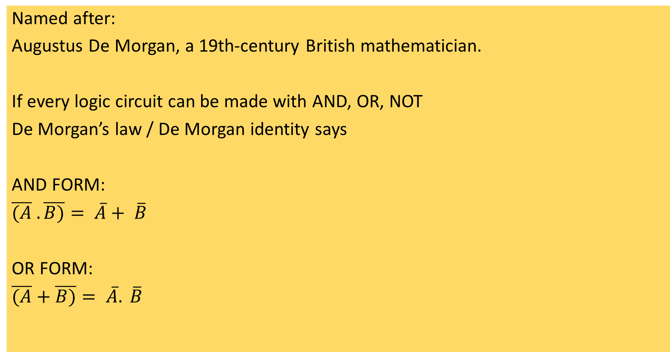
De Morgan
Named after:
Augustus De Morgan, a 19th-century British mathematician.
If every logic circuit can be made with AND, OR, NOT
De Morgan’s law / De Morgan identity says
AND FORM:
$\overline{(A} .\overline{B)}= \overline{A}+ \overline{B}$
OR FORM:
$\overline{(A}+\overline{B)}= \overline{A}. \overline{B}$

Slide 16
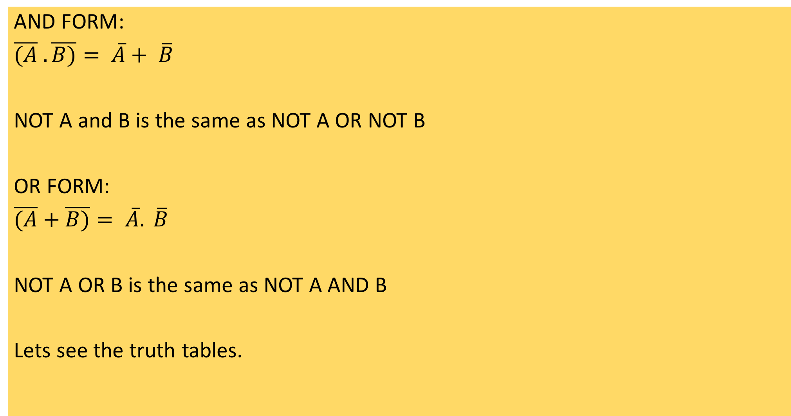
What does De Morgan mean?
AND FORM:
$\overline{(A} .\overline{B)}= \overline{A}+ \overline{B}$
NOT A and B is the same as NOT A OR NOT B
OR FORM:
$\overline{(A}+\overline{B)}= \overline{A}. \overline{B}$
NOT A OR B is the same as NOT A AND B
Lets see the truth tables.

Slide 17
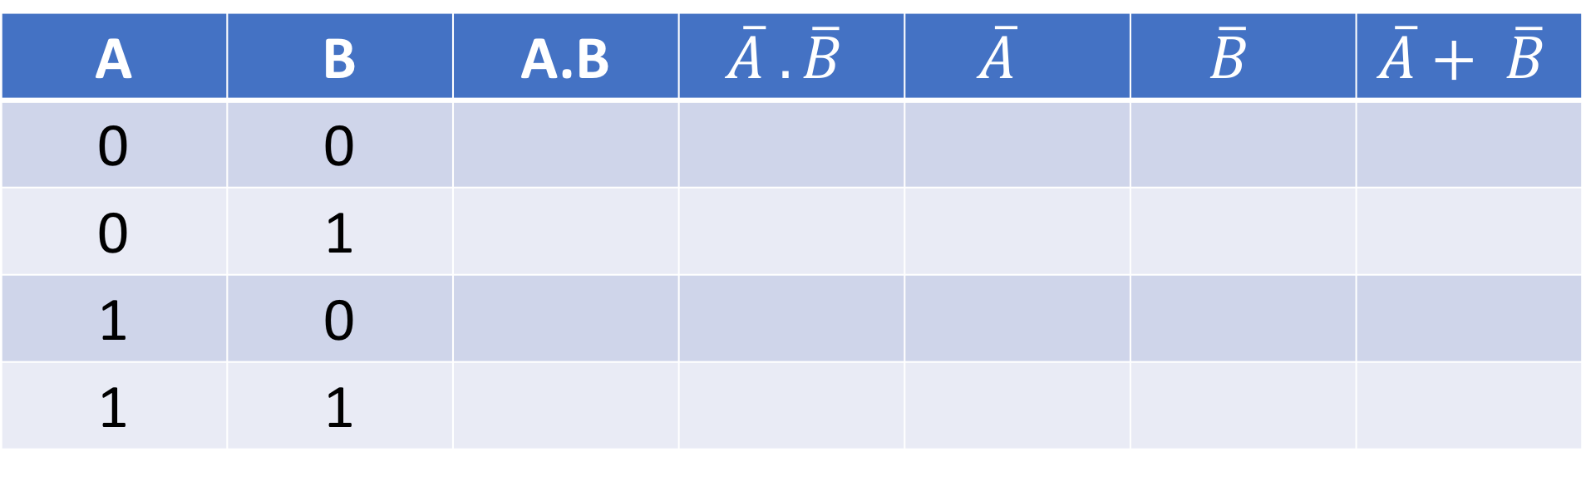
$$\overline{(A} .\overline{B)}= \overline{A}+ \overline{B}$$
NOT A AND NOT B = NOT A OR NOT B
First lets start with the possible values for positive A and B
A | B | A.B | $$\overline{A} .\overline{B}$$ | $$\overline{A}$$ | $$\overline{B}$$ | $$\overline{A}+ \overline{B}$$
0 | 0
0 | 1
1 | 0
1 | 1

Slide 18
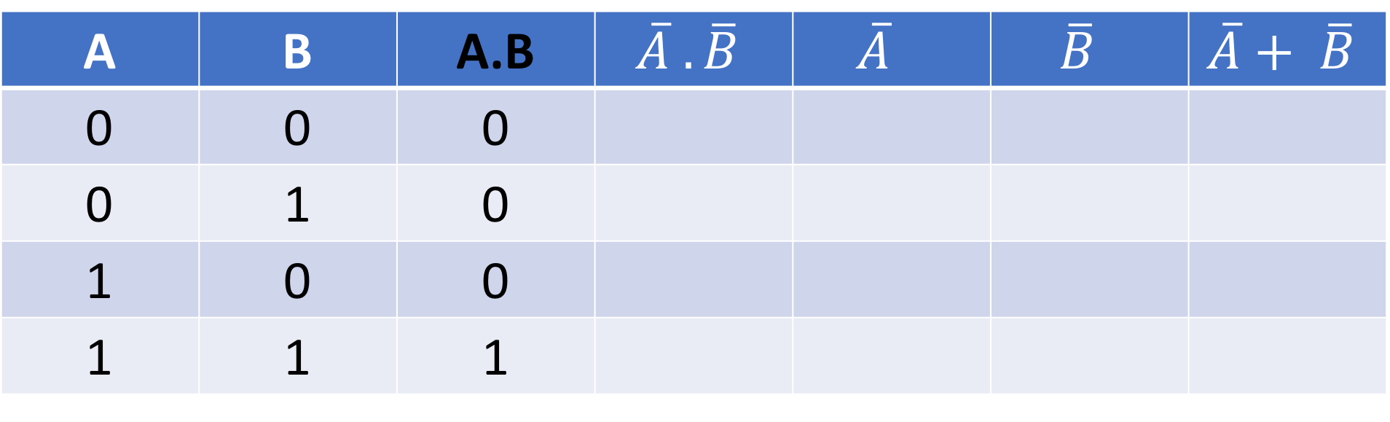
$$\overline{(A} .\overline{B)}= \overline{A}+ \overline{B}$$
NOT A AND NOT B = NOT A OR NOT B
Now do positive A AND B (A.B)
A | B | A.B | $$\overline{A} .\overline{B}$$ | $$\overline{A}$$ | $$\overline{B}$$ | $$\overline{A}+ \overline{B}$$
0 | 0 | 0
0 | 1 | 0
1 | 0 | 0
1 | 1 | 1

Slide 19
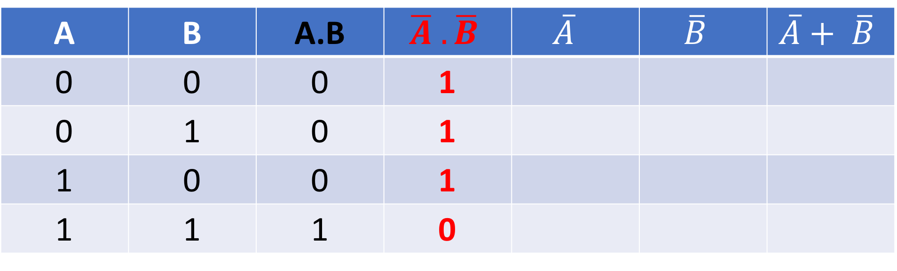
$$\overline{(A} .\overline{B)}= \overline{A}+ \overline{B}$$
NOT A AND NOT B = NOT A OR NOT B
But we want the inverse of A.B
A | B | A.B | $$\overline{A} .\overline{B}$$ | $$\overline{A}$$ | $$\overline{B}$$ | $$\overline{A}+ \overline{B}$$
0 | 0 | 0 | 1
0 | 1 | 0 | 1
1 | 0 | 0 | 1
1 | 1 | 1 | 0

Slide 20
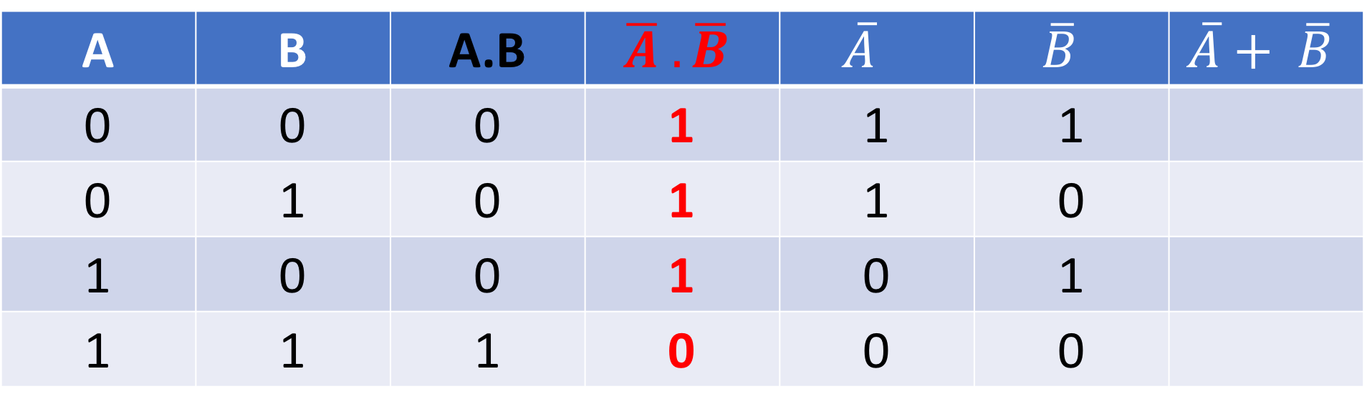
$$\overline{(A} .\overline{B)}= \overline{A}+ \overline{B}$$
That’s the left hand side done (LHS). Now to move to the right hand side (RHS)
Look at the positive value for A and now just invert it to make it NOT A
Do the same for B
A | B | A.B | $$\overline{A} .\overline{B}$$ | $$\overline{A}$$ | $$\overline{B}$$ | $$\overline{A}+ \overline{B}$$
0 | 0 | 0 | 1 | 1 | 1
0 | 1 | 0 | 1 | 1 | 0
1 | 0 | 0 | 1 | 0 | 1
1 | 1 | 1 | 0 | 0 | 0

Slide 21
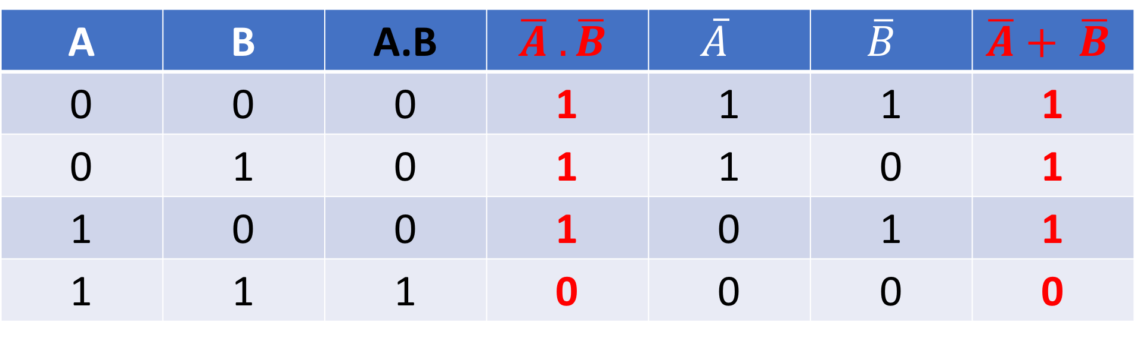
$$\overline{(A} .\overline{B)}= \overline{A}+ \overline{B}$$
Now you have NOT A along with NOT B, just do the OR function to make NOT A OR NOT B
You will see the values are the same as NOT A AND NOT B
A | B | A.B | $$\overline{A} .\overline{B}$$ | $$\overline{A}$$ | $$\overline{B}$$ | $$\overline{A}+ \overline{B}$$
0 | 0 | 0 | 1 | 1 | 1 | 1
0 | 1 | 0 | 1 | 1 | 0 | 1
1 | 0 | 0 | 1 | 0 | 1 | 1
1 | 1 | 1 | 0 | 0 | 0 | 0

Slide 22
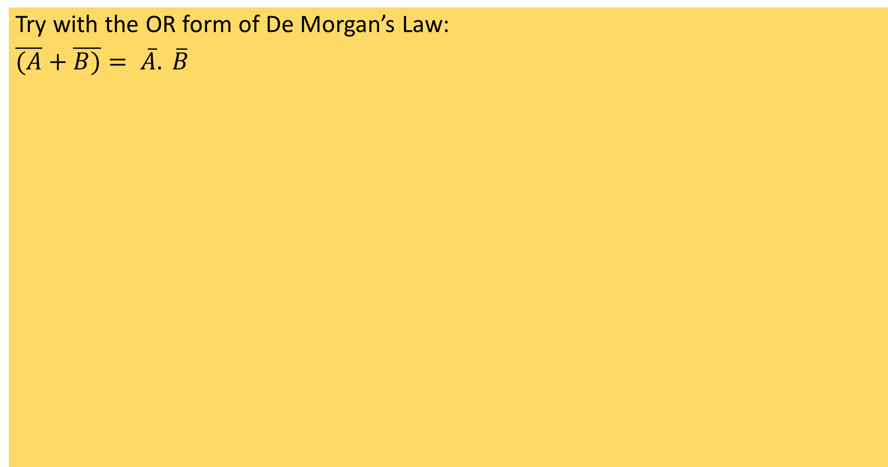
Task
Try with the OR form of De Morgan’s Law:
$\overline{(A}+\overline{B)}= \overline{A}. \overline{B}$

Slide 23
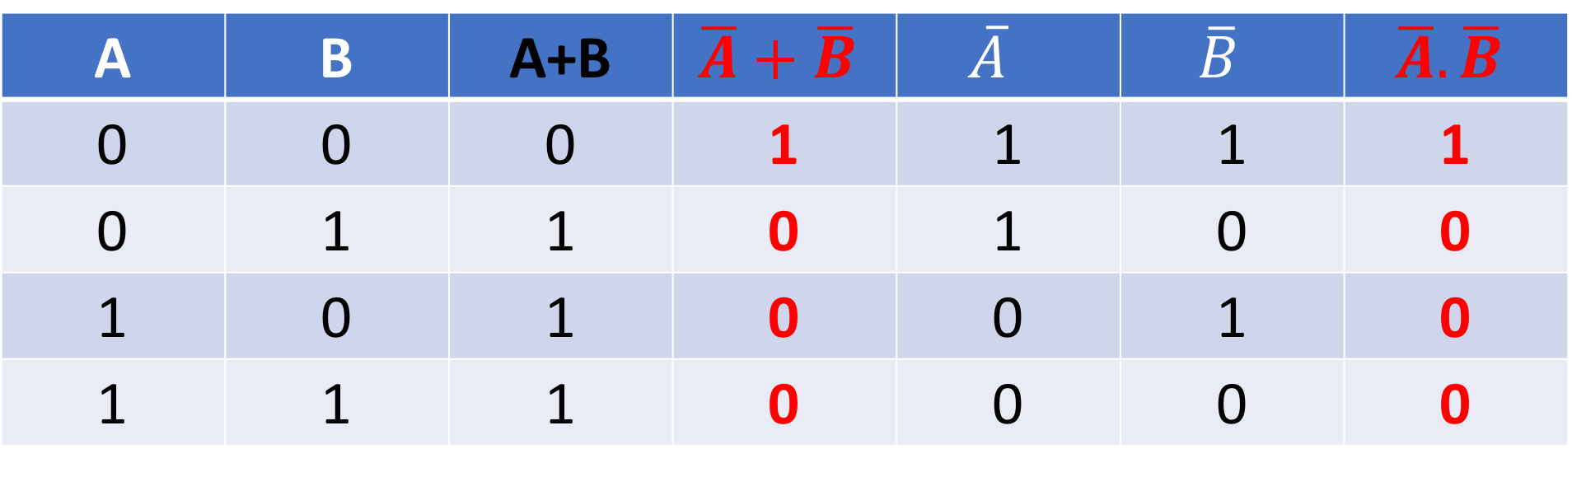
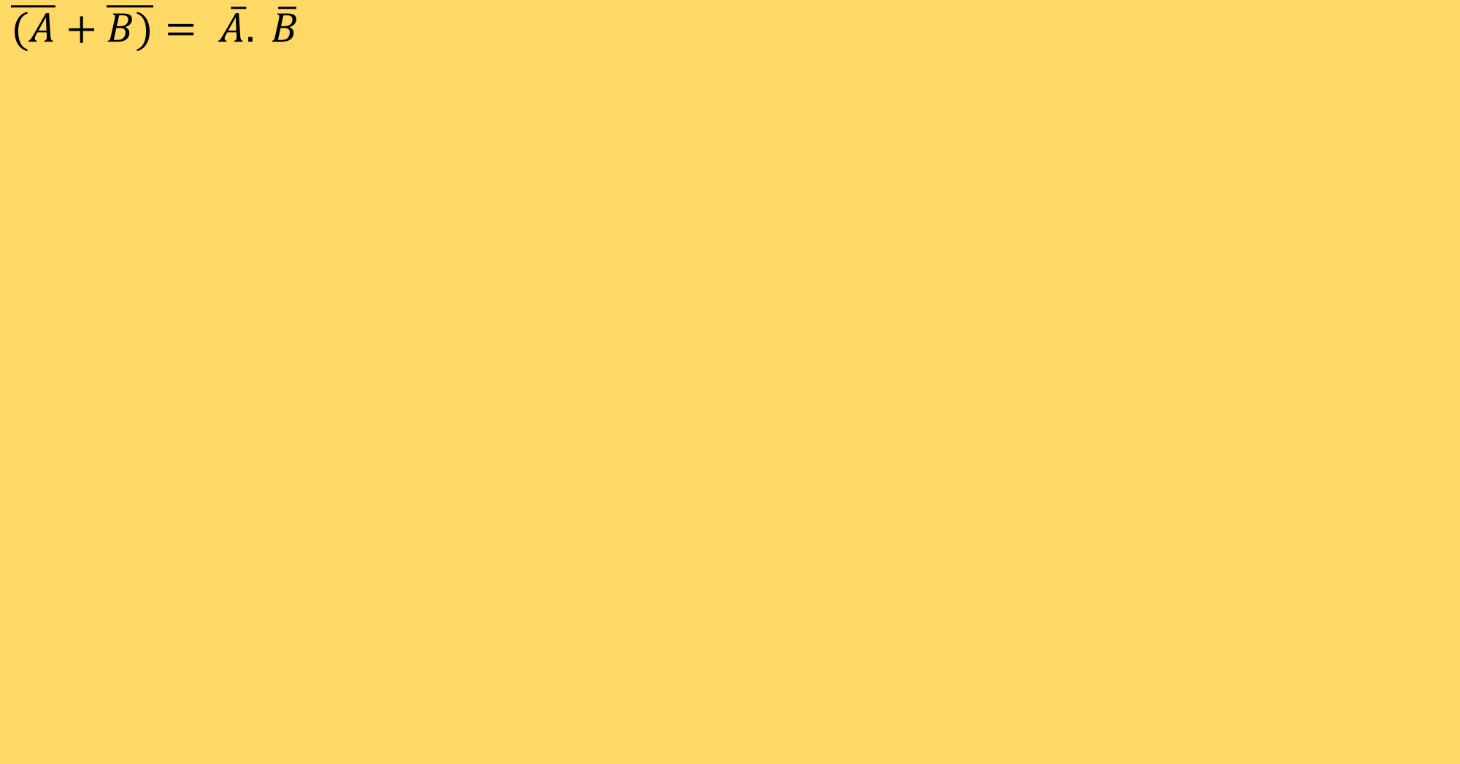
ANSWER
$\overline{(A}+\overline{B)}= \overline{A}. \overline{B}$
A | B | A+B | $$\overline{A}+\overline{B}$$ | $$\overline{A}$$ | $$\overline{B}$$ | $$\overline{A}. \overline{B}$$
0 | 0 | 0 | 1 | 1 | 1 | 1
0 | 1 | 1 | 0 | 1 | 0 | 0
1 | 0 | 1 | 0 | 0 | 1 | 0
1 | 1 | 1 | 0 | 0 | 0 | 0

Slide 24
So What?
Allows you to simplify equations
1: Break apart NOTs
2: Change the operator (AND to OR / OR to AND)
Example video:

Slide 25

Simple

Slide 26

Complex

Slide 27

Page 272
Cambridge course book has an example….

Slide 28
Today
1. Produce truth tables for logic circuits including half adders and full adders
5. May include logic gates with more than two inputs.
Understand: What are half-adders and full adders
Able: Produce a truth table for them
Answer: Where are they used

Slide 29
Before we continue
Its important to remember logic gates and their truth tables.
Also its important to note that when companies make something, they usually want it as cheap as possible.
If you wanted to create something that has an AND gate followed by a NOT gate, its cheaper to use a NAND gate. One gate is cheaper than having two.
What’s even cheaper is if, in your whole circuit you just use one type of gate.
So reducing the number of gates is good. But using only one gate type is even better, even if it means you have many more gates in total – if they are all the same type of gate its cheaper.

Slide 30
Binary Addition
0 + 0 = 0 0 + 1 = 1
1 + 0 = 1
1 + 1 = 0 carry 1
This is a half adder. Note that we have 2 inputs
In block form:
X is an input
Y is an input
S is the Sum
C is the carry
X
Y
1 Bit Half Adder
S
C

Slide 31
Half Adder
1 Bit Half Adder
If you was to draw a truth table for this:
You will notice that the output for the sum column is the same as a truth table for an XOR gate.
The carry column is the same as a AND gate
So a logic circuit that has an AND gate and XOR gate where the inputs for each gate are
the same would provide half adder functionality
But remember we want to reduce the number of gates and even better if we just use one gate type
X
Y
S
C
A | B | S | C
0 | 0 | 0 | 0
0 | 1 | 1 | 0
1 | 0 | 1 | 0
1 | 1 | 0 | 1

Slide 32
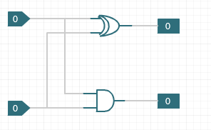
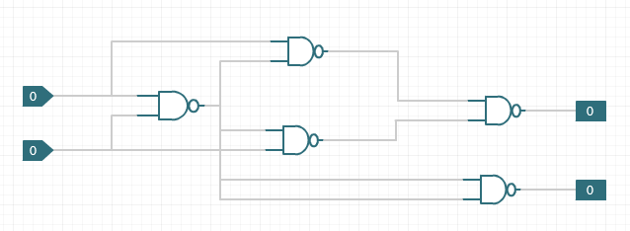
Half Adder Example
So we can have this:
But having one gate type, even if it means having more total gates is preferred.
Draw a truth table for the NAND gate circuit – does it match up to half adder?

Slide 33
Answer
A
D
C
A
C
F
C
E
B
B
C
G
C
A | B | C | D | E | F (SUM) | G (CARRY)
0 | 0 | 1 | 1 | 1 | 0 | 0
0 | 1 | 1 | 1 | 0 | 1 | 0
1 | 0 | 1 | 0 | 1 | 1 | 0
1 | 1 | 0 | 1 | 1 | 0 | 1

Slide 34
Full adder
This has 3 inputs.
Two inputs from the original equation and the third input is the carry bit.
Two half adders connected.

Slide 35
Video Tasks and Questions
Tasks
Draw a full adder logic circuit diagram
Draw a full adder but only using one gate type (NAND)
Draw a truth table for a full adder
Questions
What is the Boolean equation for full adder?
Why does it use 3 bits?
What is the weight of the sum bit?
What is the weight of the carry bit?
How many extra OR gates are needed for full adder?
Which gates can implement a full adder?

Slide 36
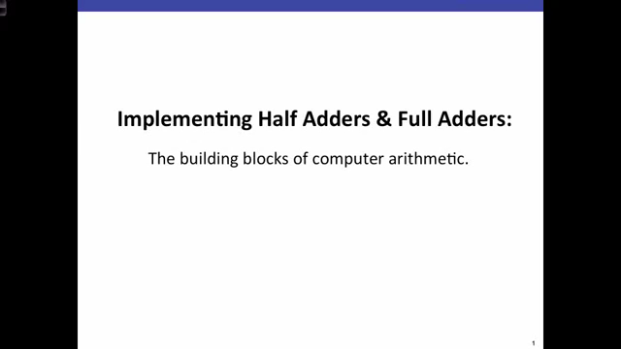

Slide 37
Today
2. Show understanding of a flip-flop (SR, JK)
3. Show understanding of Boolean algebra 6. Draw a logic circuit and derive a truth table for a flip-flop
7. Understand of the role of flip-flops as data storage elements
Understand : What are flip flops
Able : Explain JK flip flops
Answer : Where are flip flops used?

Slide 38
Flip Flops
Everything we have done with logic gates have been combinational circuits.
That means the output of that circuit is dependant only on the inputs of that circuit
Now we will look at sequential circuit where the input of a gate is the output from another.
There are a few types
SR flip flops
JK flip flops

Slide 39
SR Latch / Flip Flop
The Set Reset latch also called Set Reset Flip flop
The output of one gate is the input of another
They are used to store a 1 bit value (0 or 1) for example when dealing with power supplies, you either want power or not. For example when you want power to go to RAM to make sure data stays.
Made with either two NAND gates or you can make it with two NOR gates

Slide 40
Quick Refresh. NOR and NAND
Input A | Input B | Output
0 | 0 | 1
0 | 1 | 0
1 | 0 | 0
1 | 1 | 0
Input A | Input B | Output
0 | 0 | 1
0 | 1 | 1
1 | 0 | 1
1 | 1 | 0

Slide 41
SR Flip Flop
Here we have input R (reset) and input S (Set)
We also have two outputs Q and (not)Q
The Q output is one of the inputs for S
The (not)Q output is one of the inputs for R

Slide 42
SR Flip Flop
Draw a truth table for SR flip flop
You will need to know what at least Q or Q’ will be
You notice there is not
S =1 and R =1 simultaneously. If this happens the outputs would want to be 1 and 0 simultaneously and this is invalid.
Input |  | Initial |  | Final
S | R | Q | Q’ | Q | Q’
0 | 0 | 0 | 1
0 | 0 | 1 | 0
0 | 1 | 0 | 1
0 | 1 | 1 | 0
1 | 0 | 0 | 1
1 | 0 | 1 | 0

Slide 43
SR Flip Flop
Draw a truth table for SR flip flop
This time with NAND gates
Input |  | Initial |  | Final
S | R | Q | Q’ | Q | Q’
0 | 0 | 0 | 1
0 | 0 | 1 | 0
0 | 1 | 0 | 1
0 | 1 | 1 | 0
1 | 0 | 0 | 1
1 | 0 | 1 | 0

Slide 44
JK flip flop
Because SR flip flop cannot have S as 1 and R as 1 at the same time.
We can use JK flip flop.
The other reason we use JK is because with SR we are not sure what states the inputs are and if they even arrive at the same time.

Slide 45
JK flip flop
Task: (you can use the video to help you)
At least 5 minute presentation / video
1: Draw a circuit diagram for a JK flip flop
2: Draw a truth table for JK flip flop
3: Can you use any gates for JK flip flop?
4: What is a clock pulse and why do do we need it?
5: How can you convert SR flip flop to JK?
6: What does JK actually stand for?

Slide 46

JK flip flop
Because SR flip flop cannot have S as 1 and R as 1 at the same time. We can use JK flip flop.

Slide 47
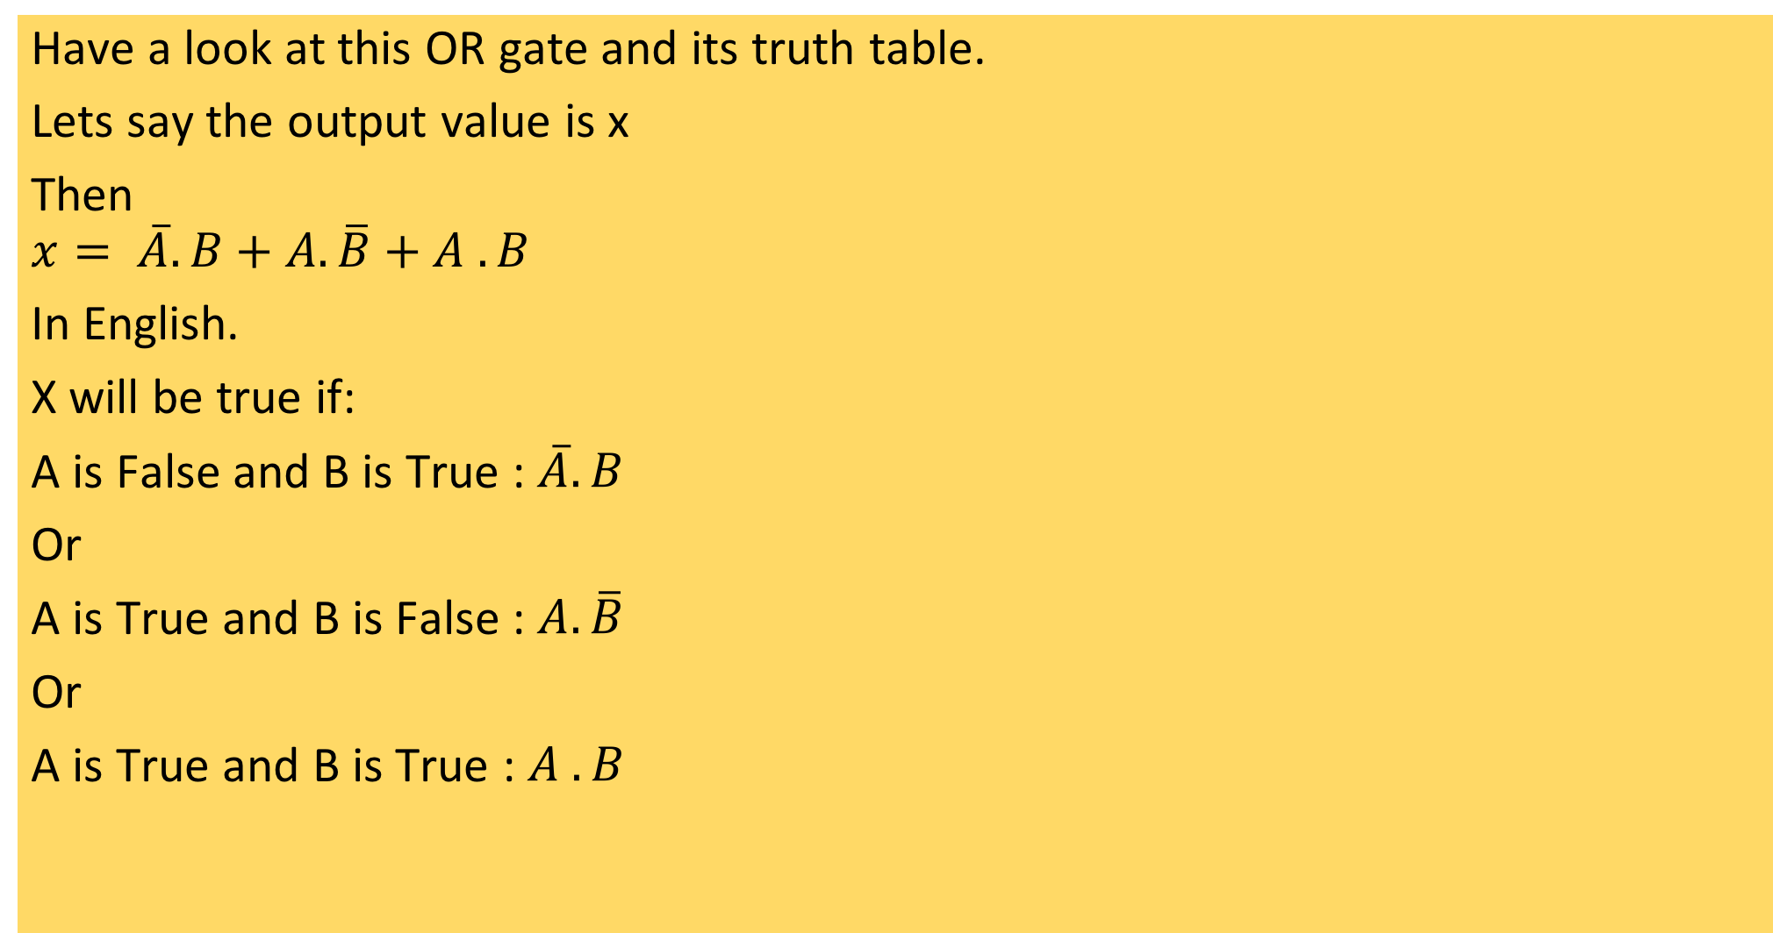
Boolean Algebra
Input A | Input B | Output
0 | 0 | 0
0 | 1 | 1
1 | 0 | 1
1 | 1 | 1
Have a look at this OR gate and its truth table.
Lets say the output value is x
Then
$$x= \overline{A}.B+A.\overline{B}+A . B$$
In English.
X will be true if:
A is False and B is True : $\overline{A}.B$
Or
A is True and B is False : $A.\overline{B}$
Or
A is True and B is True : $A . B$

Slide 48
Task
Draw a logic circuit.
Give it to someone
They have to write the Boolean algebra to it
Check out worked example 18.02 on page 276

Slide 49
15.2 Boolean Algebra and Logic Circuits
4. Show understanding of Karnaugh maps (K-map)
11. Understand of the benefits of using Karnaugh maps Solve logic problems using Karnaugh maps
Understand : What are Karnaugh maps
Able : Write a Karnaugh map
Answer : How are K-maps used to simplify Boolean algebra

Slide 50
Karnaugh Maps (K maps)
A Karnaugh map is just a simple way to represent Boolean algebra.
There are some rules:
We only care about cells with 1s
If cells have a 1, group them with a rectangle
Each group should be as large as possible
Group can overlap
Groups must be powers of 2, (2,4,8,16,32,64….)
Only one variable can change when drawing out the map

Slide 51
OR gate Karnaugh
Input A | Input B | Output
0 | 0 | 0
0 | 1 | 1
1 | 0 | 1
1 | 1 | 1
A
B
 | 0 | 1
0 | 0 | 1
1 | 1 | 1

Slide 52
OR gate Karnaugh
A
Lets look at our first group (red).
The value of A remains the same
So we can start to build our equation
X = A
B
 | 0 | 1
0 | 0 | 1
1 | 1 | 1

Slide 53
OR gate Karnaugh
A
We have X = A
Our next group (blue) shows that B
stays the same
So we can say x is true
if A is true or B is true
X = A + B
B
 | 0 | 1
0 | 0 | 1
1 | 1 | 1

Slide 54
Try this:
A | B | C | X
0 | 0 | 0 | 0
0 | 0 | 1 | 1
0 | 1 | 0 | 0
0 | 1 | 1 | 1
1 | 0 | 0 | 0
1 | 0 | 1 | 1
1 | 1 | 0 | 1
1 | 1 | 1 | 1

Slide 55
Answer
BC
The red group shows that the value of C does not change.
The blue group shows that A along with B does not change
So x = AB + C
 | 00 | 01 | 11 | 10
0 | 0 | 1 | 1 | 0
1 | 0 | 1 | 1 | 1
A

Slide 56
How to write the map
BC
It does not matter if you do A and BC, or AB and C.
But notice that BC reads 00, 01, 11, 10 not 00, 01, 10, 11. The reason for this is that one variable can change.
00 = B is 0, C is 0
01 = B is still 0, C changes to 1
11 = Now B changes but C is the same
10 = B is the same but C changes
 | 00 | 01 | 11 | 10
0 | 0 | 1 | 1 | 0
1 | 0 | 1 | 1 | 1
A

Slide 57
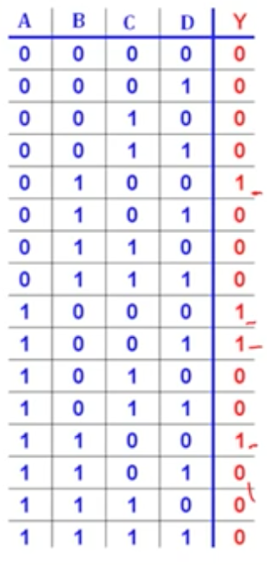
Try this

Slide 58
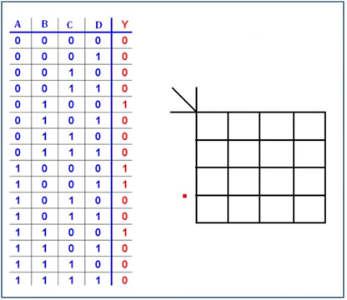

Slide 59
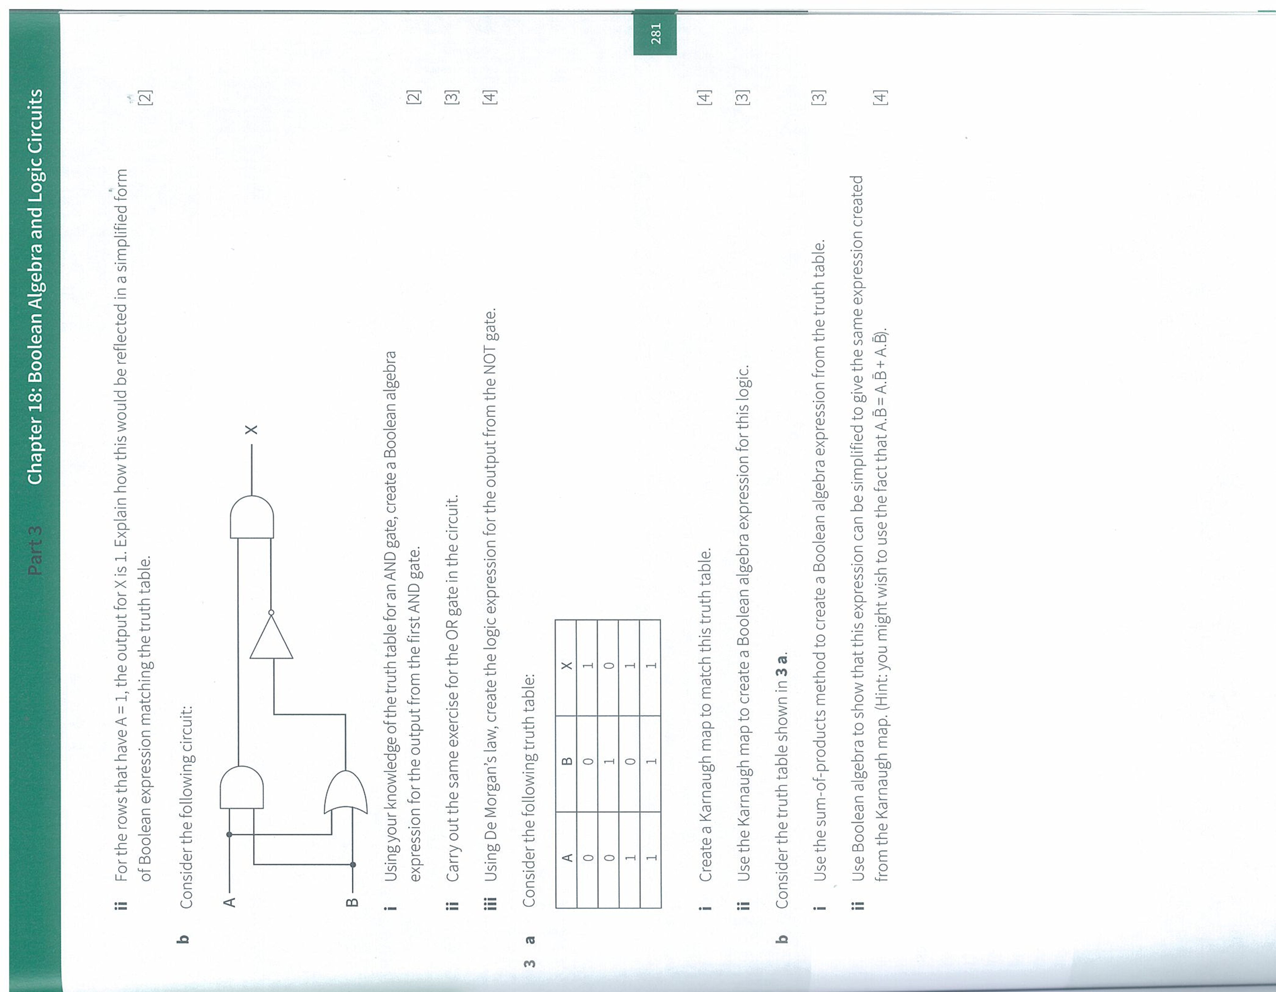
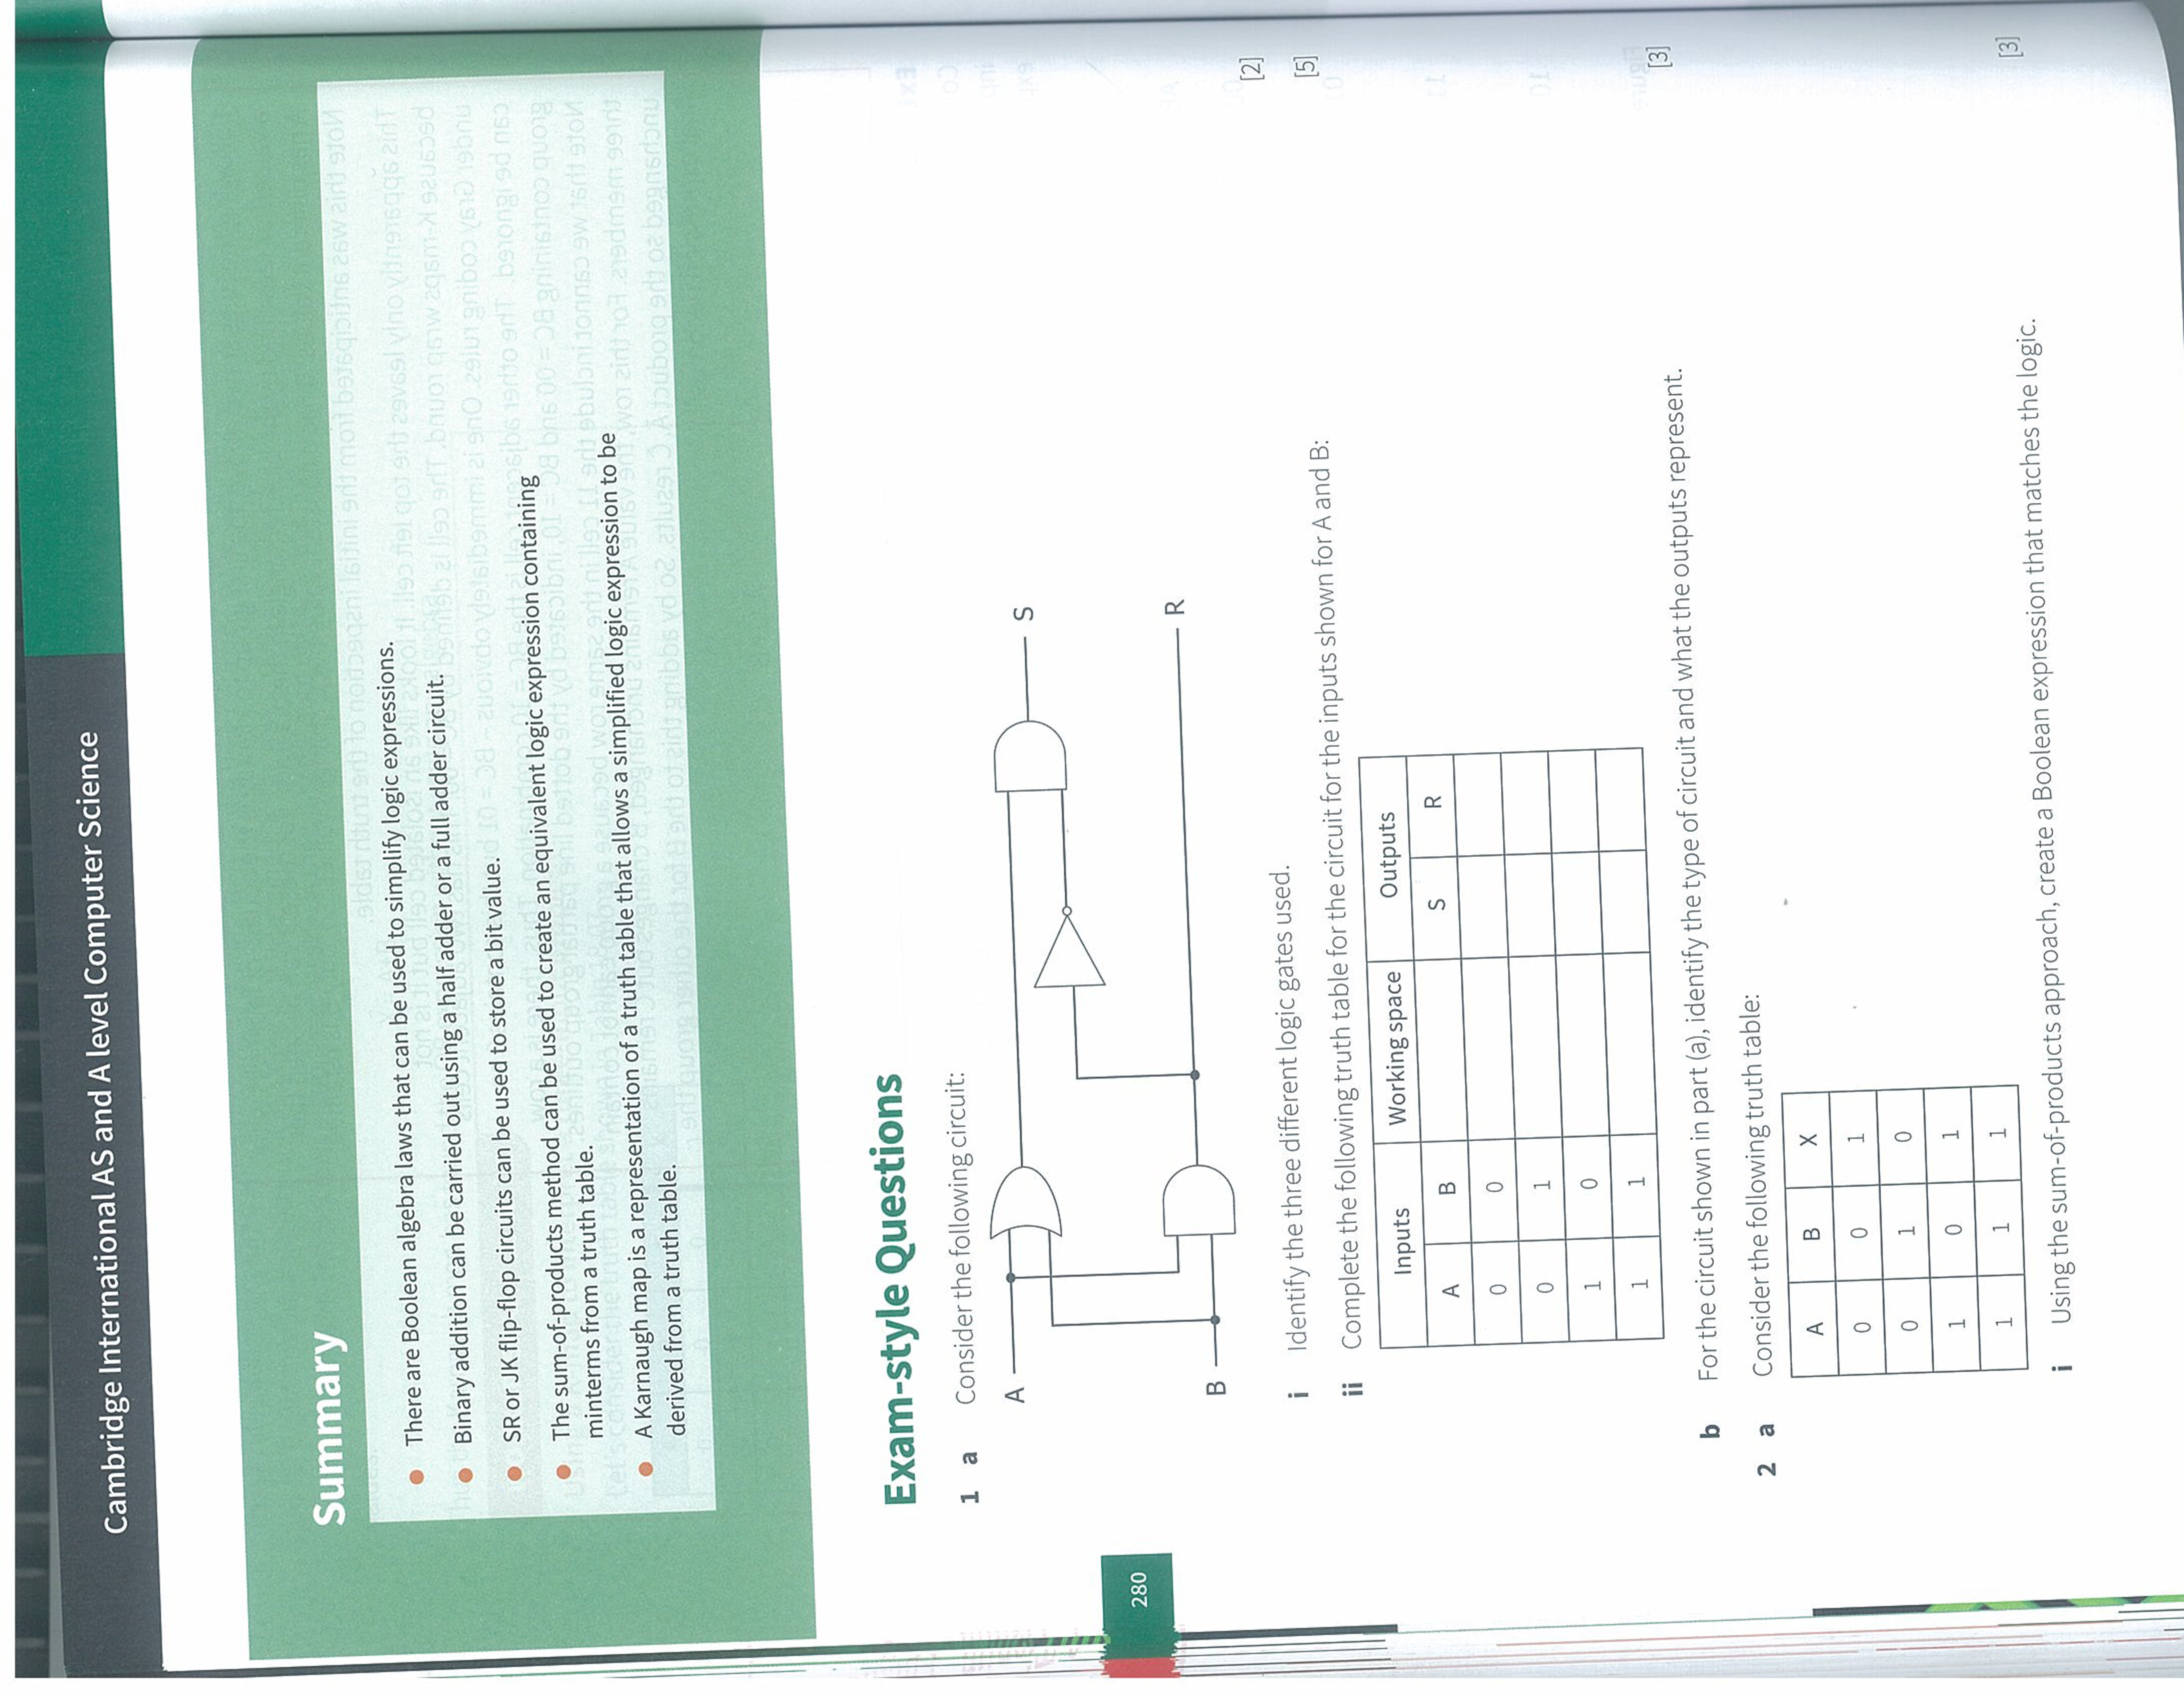

Slide 60
9608/31/MJ/16 Q1
9608/31/MJ/16 Q5
9608/03/SP/15 Q5
9608/31/MJ/16 Q6

